Slide 1
Famous Local Residents

Slide 2
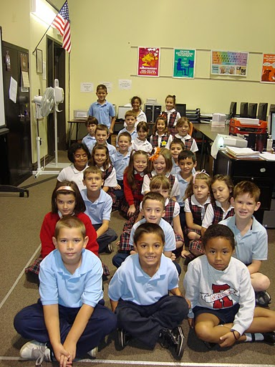
Famous People From Illinois
Created by 2nd graders from:
Cathedral of St. Raymond School
Joliet, IL USA

Slide 3
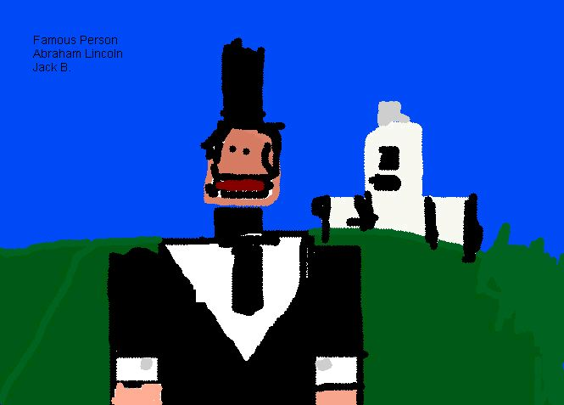
Abraham Lincoln

Slide 4
George E. Hale
George

Slide 5
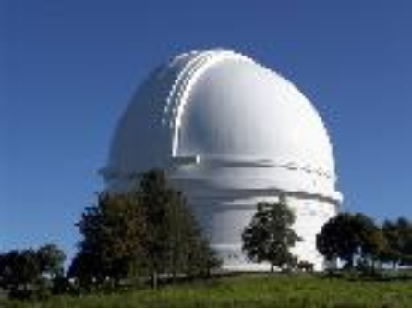
george’s job
George was an astronomer

Slide 6
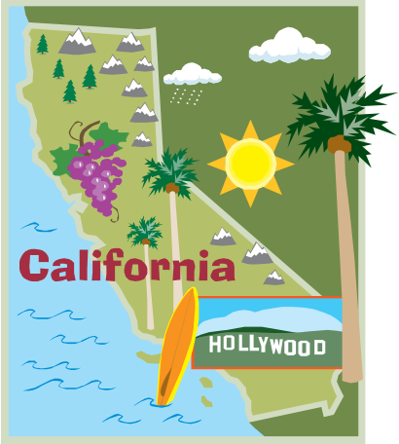
Where George was born
George was born 1868 in Pasadena , California

Slide 7
Famous person in Ilinois
By Bailey P

Slide 8
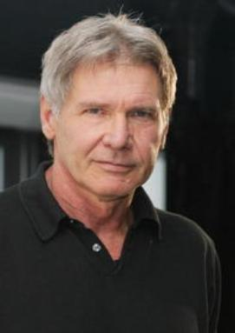
Harrison Ford
Harrison Ford was born Joly 13, 1942

Slide 9
Harrison Ford
He was in the movie Indiana Jones

Slide 10
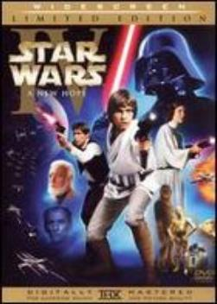
Harrison Ford
He was also in star wars

Slide 11
Famous People...not from Illinois!
They were too cute not to add...

Slide 12
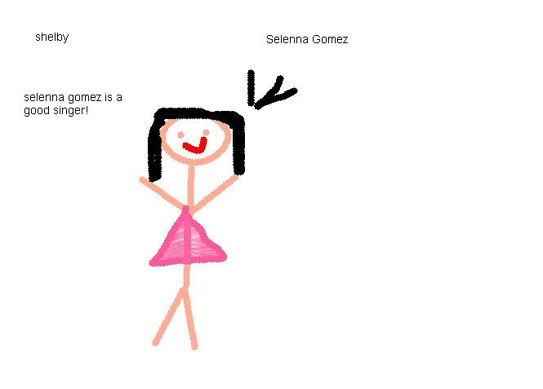
Selena Gomez!

Slide 13
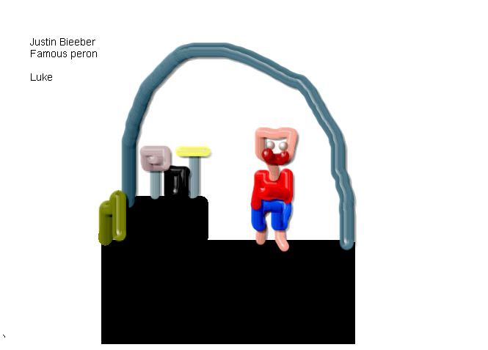
Justin Beiber - not from Illinois!

Slide 14
Learning Circle Group: CCE1
Famous Residents of Our City
Fourth Grade Students
School classes I-VIII Liliesti Baicoi
Primary Teacher Nina Ilie

Slide 15
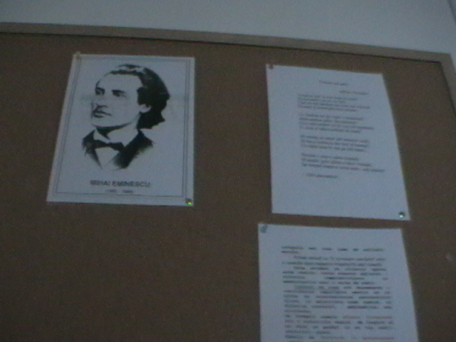
Love and admiration for the beauty of the homeland and its people are beautifully painted by our greatest artists: sculptures of Constantin Brancusi in his beautiful paintings Nicolae Grigorescu, Mihai Eminescu in his masterpieces.
Mihai Eminescu-Roman Lucifer

Slide 16
Mihai Eminescu - Medallion literary

Slide 18
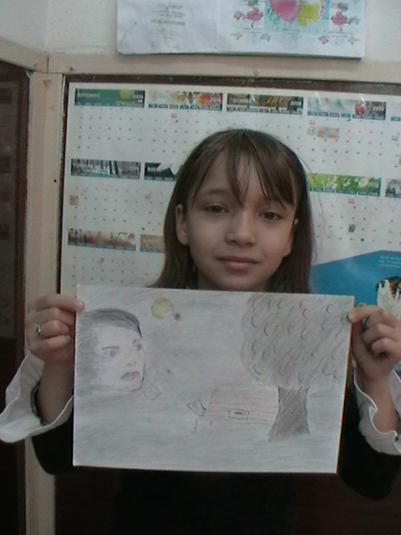
Eminescu my idol
November children are small, But all are united. We help one another And the worries and needs. But us as we grow We arrive, do intellectuals? Teachers, doctors, what will be Even poets we become.
As Eminescu, a smart, What was a poet in his life. The nature and inspired And we are delighted ... With many beautiful poems. The young man, he went ... But in our hearts, endures. And shine like a Morning Star Up on the stars.
Ţeţu Miruna, fourth grade
Perşunaru Cătălina, grade IV

Slide 19
Discovering Eminescu it eyed child
Outside you can hear the happy voices of children has been blanketed with snow covering the ground with a white blanket and fluffy. It is evening and snow, stars and snowflakes seem that drops from the sky, as if someone would sift. After a day that I enjoyed myself playing with the cold snow, I sat in the armchair in front of the window with a cup of hot chocolate and a book. I knew before the winter holiday on Eminescu, I knew it, "Evening Star" of Romanian poetry, the greatest poet ever had in our country. When I bought this book along with her mother so beautiful covers. I wanted very much to read something written by Eminescu moment had come. I opened it at random and found a photograph of a young man with big eyes, long black hair combed back. Mihai Eminescu was. I was thrilled with the thought that a young engineer, whom I read works after so many years and many millions of children thought I learned about him since then, having the good fortune of being known through his masterpieces. Slowly back by the page and the images appear before my eyes a rare beauty: see deep forests, beautiful colored birds, long and undulating fields, lime roots strongly embedded in giant earth, blue lake full of lilies, which floats a boat, tall poplars that bends in the wind, the moon reflected in the clear water of the lake, the stars that the sky rife, and among them Lucifer that looks extremely beautiful girl, crying in the window of a castle. I imagine these things as I feel great and want to read more and more, until the points are transformed into birds who fly on the white page and I fall asleep happy that I found at least part of what it called.
Parvulescu Ana Maria, grade IV

Slide 20
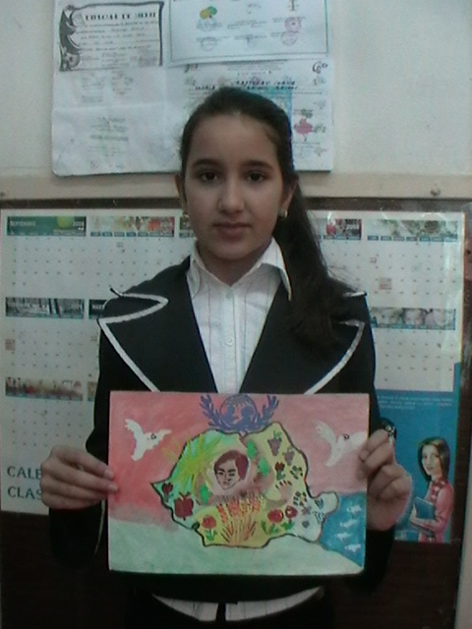
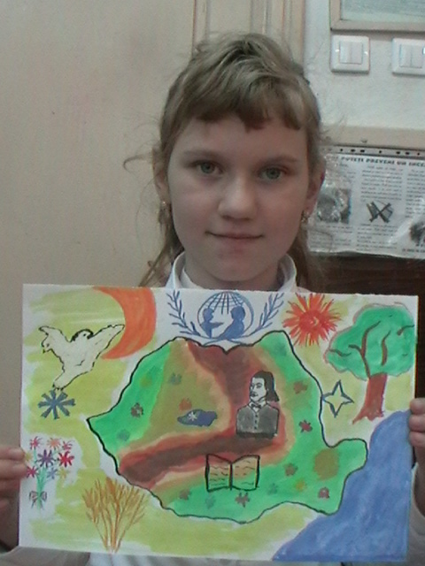

Slide 21
Mihai Eminescu Romanian Evening
Mihai Eminescu is the greatest poet of tutror time, called the Morning Star Romanian poetry. It was born on 15 January 1850 at Botosani. Since I was small, was different from others because he spent so much time in the woods, preferring to admire nature, instead of playing with children his age. The greatest Romanian poet and one of the great lyrical world, Mihai Eminescu was impressed by the charm of homeland, while evocative of a national history rich in heroes and deeds of glory. Charming descriptions of nature, the feelings down on paper, it makes you dream and every word to go back in time. 'As a child wandered forests "says the poet. The school years, are interested in theater, poetry and culture. He loved nature, lake, forest, lime blossom, spring, summer nights, stars ... stars. I think and I imagine, as one evening, on a bench under a lime tree, stood thoughtfully Mihai Eminescu. Lifting his gaze to the sky through the branches of lime, the poet saw the evening star, the brightest star in the sky, but also single. Luceafãrului glitter and got drunk and filled their eyes and soul. So I guess that was born this wonderful poem, which is of paramount importance to us, all Romanians. After he composed this poem and left over lime, bright as the sun and moon loving, left for New Morning Star. Every night, when I read this poem, I look the stars and found that Morning Star is there waiting for me as inspired and Mihail Eminescu. The great poet in his lyrics and sang the beauties of nature, the history of our people and the peoples of the world, love and exploited by brilliantly in their poetry and prose as part of our popular creation. Considered, Romanian poetry evening star ", lifted on top of the Romanian language expressiveness, managed to highlight the value and richness of means of expression and beauty.
Persunaru Catalina, grade IV

Slide 22
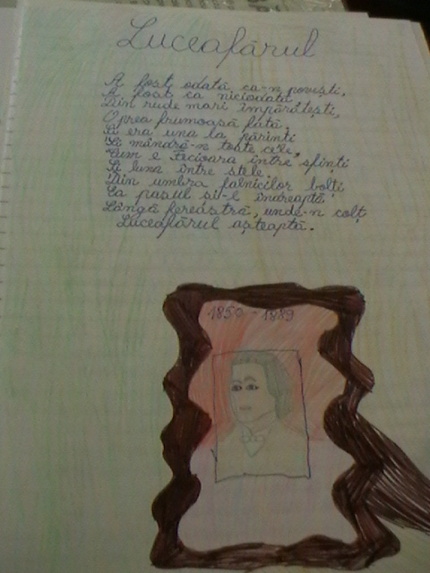
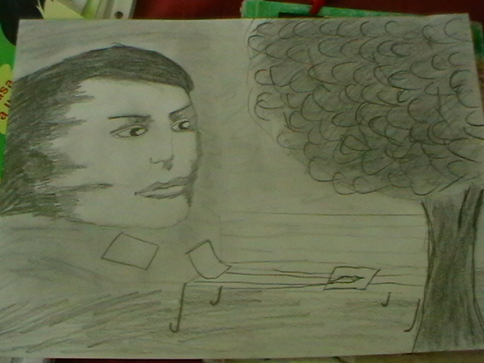
,, What swing, woods, No rain, no wind, The branches to the ground?"

Slide 23
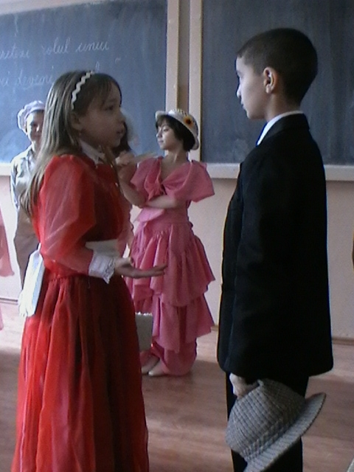
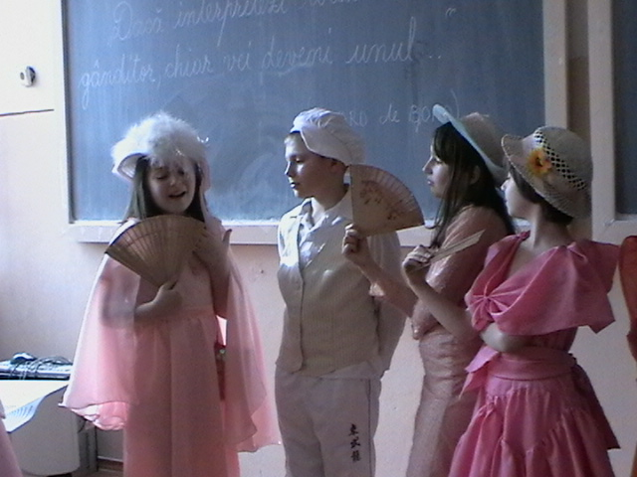
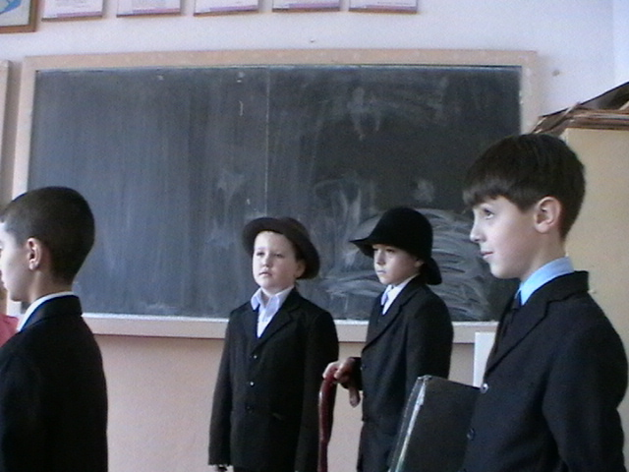
Dramatizing - great writer ION LUCA CARAGIALE

Slide 24
Fourth Grade Students
The school grade I-VIII-Băicoi Lilieşti
The recently
Primary Teacher Nina Ilie

Slide 25
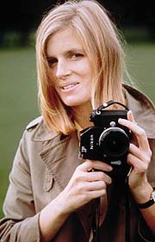
Famous People From Scarsdale
By, Rachel and Caroline
Did you know that famous people lived in Scarsdale? Well, for example, Linda McCartney was born in Scarsdale in 24/9/1941. If you don’t know who Linda was, she was a famous photographer and the wife of Paul McCartney, one of the beetles. She died in 4/17/1998 because of breast cancer in Tucson, AZ. Saddness.

Slide 26
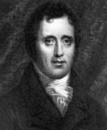
Another famous person was Daniel D. Tompkins. He was born June 21, 1774. I didn’t even know Scarsdale was a town then! When James Monroe was president, he became vice president. They have no idea how he died except for the date and the place, which is 6/11/1825, Staten Island in New York.

Slide 27
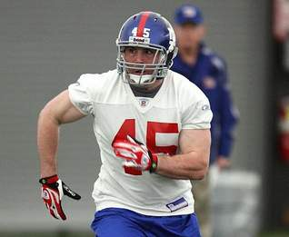
The third example, Matt Bernstein, was an NFL player. He was born 12/26/1982. He played for the Detroit Lions. He got put into The National Jewish Sports Hall Of Fame. And guess what? He’s still alive.

Slide 28
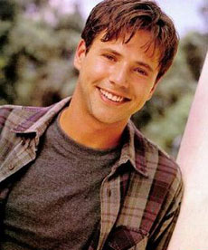
Last but not least, is David Lascher. He was born on a Thursday, in April 27, in 1972. He is famous Actor. David also went to the Scarsdale High School and grew up here. He was Ted McGriff on “Hey Dude” from Nickelodeon. He also was on “Sabrina the Teenage Witch” and also in the finals of “American Idol.” His other TV series were, “Two of a Kind,” “Veronica's Closet,” “White Squall,” “The Flood: Who Will Save Our Children?” “Blossom,” “Beverly Hills,” “Step by Step,” “Full House,” “Roseanne,” and “Life Goes On.”

