Slide 1
Global Collaboration
Mrs. Dean’s Seventh Grade Science Students

Slide 2
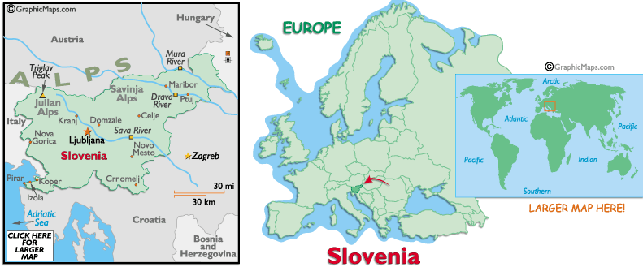
OS Trnovo School in Ljubljana, Slovenia.

Slide 3
The Beginning

Slide 4
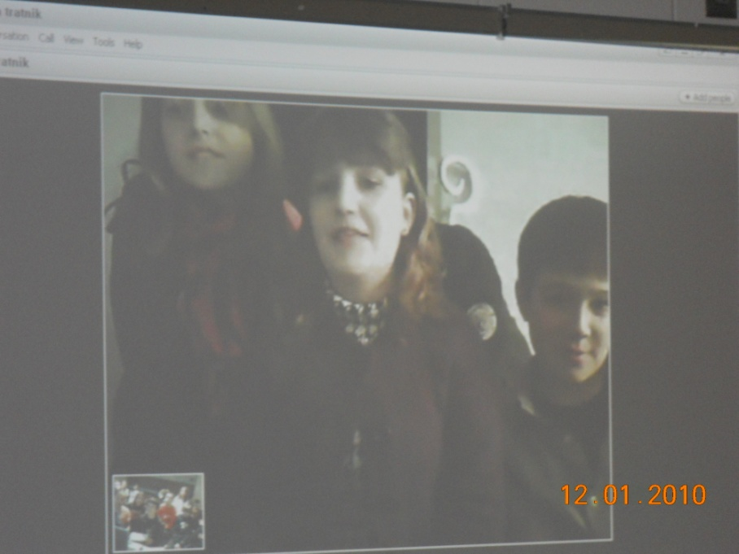
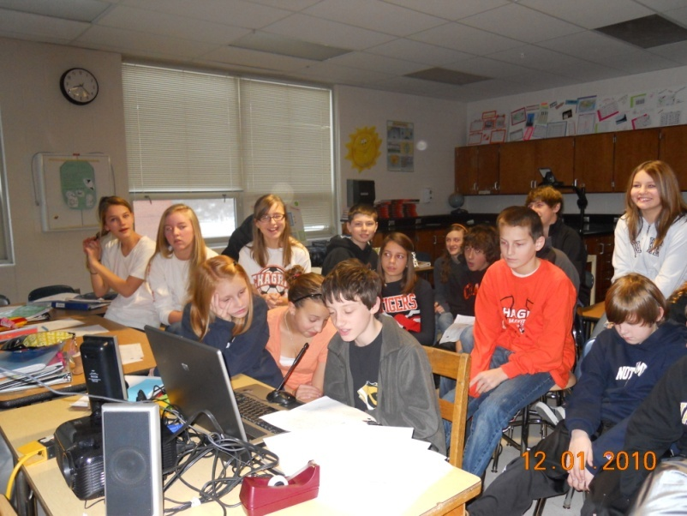
Year-long Collaboration

Slide 5
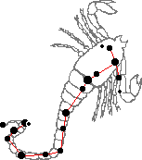
Constellation Project
Scorpius
Andraz Tavcar ( he read for Ziva Coklin who is ill)
Hollis Roush

Slide 6
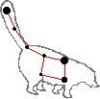
Constellation Project
Ursa Minor
Madelyn Michaels

Slide 7
Constellation Project
Delphinus
Anja Kotar
Amanda Vickers

Slide 8
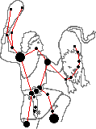
Constellation Project
Orion
Reese Russo

Slide 9
…….And more to come

