Slide 1
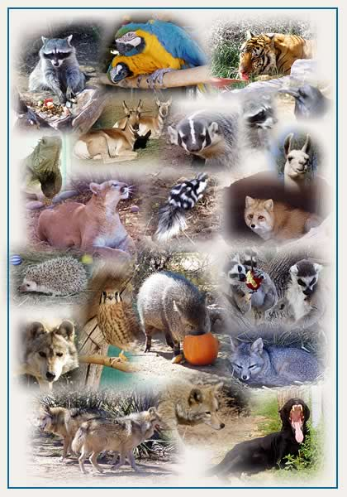
Pets and Animals in our World!

Slide 2
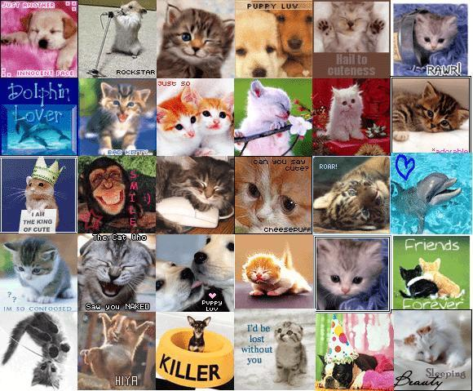
Little animals are found in houses or places all around the world. People have different types of animals that mean more than other animals. People love their animals and If they are good owners they would be treated good. some animals are kept inside and some aren’t. some animals like dogs or cats could be strays and eat food and live in animal shelters. Animals can live in nature reserves. There are six nature reserves in jordan. People breed their animals with the same kind or a different kind of the animal. I have a ori pei (dog) which is a mix of a pug and a shar-pei. I have to train her to be good in a house because we live on the second floor of our building. We also had to take her to the vet to get shots and her checkups.

Slide 3
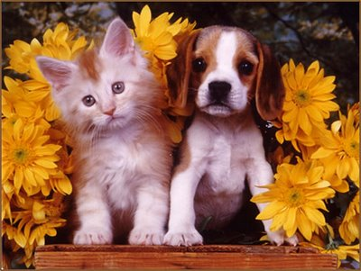
Animals in Sloveina
Stork- It is protected by the law. It builds its nest in trees, chimneys, and electrical posts.
Olm- A blind amphibian endemic that lives in caves underground of Southern Europe.
Lipizzan- A breed of a horse.
Lynx- Has big ears and is a wild cat.
Kočevje- A brown bear that lives in their forests.
Cats, dogs, hamsters, mice, parrots, and rabbits- The owners care about them a lot and are pleased to have them.

Slide 4
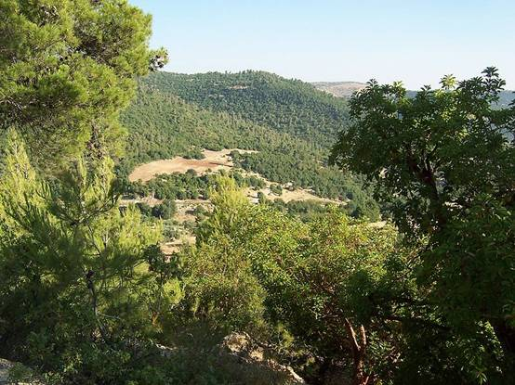
Animals in Jordan
Birds and cats- People have these animals in their house.
Most rabbits and cats are kept outside.
They have six different nature reserves.

Slide 5
Lots of animals
Lots of people in the world have animals or see animals every day. Most people who own animals are kind to them but some people don’t like them because of what they were told when growing up.

