Slide 1
Sports
National sports and their famous athletes around the world.

Slide 2
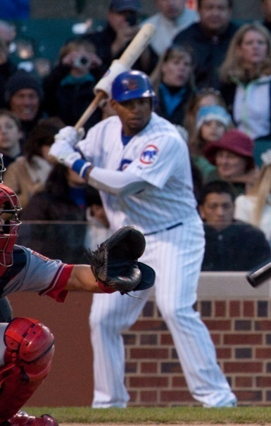
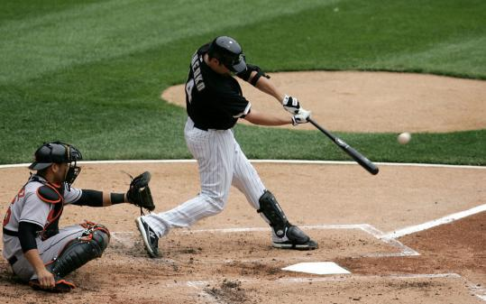
American Baseball Sport Players
Baseball is also known as the American Pastime.
It is the United States’ National Sport.
It was invented in 1845.
About 30 major league teams in the U.S.
At least 1,000,000 people attend a baseball game each year.
There are 2 teams where we live. Chicago Cubs and White sox.
The stars are Paul Konerko (WhiteSox), Marlon Byrd(Cubs)

Slide 3
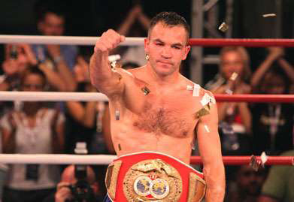
Slovenia Sportsmen
Dejan Zavec is a professional boxer who holds a championship title.
32 Wins – 1 loss – 1 NC
Tina Maze is an alpine ski racer in the World Cup Circuit.
Received 3 silver medals.
Anze Kopitar is the best slovenian hockey player.

